Slide 1
Asymptotic Analysis
Notes:
1

Slide 2
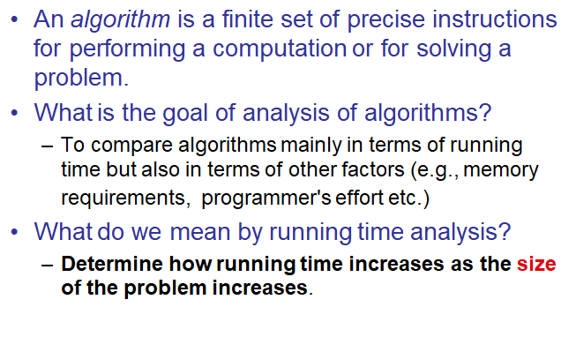
Analysis of Algorithms

Slide 3
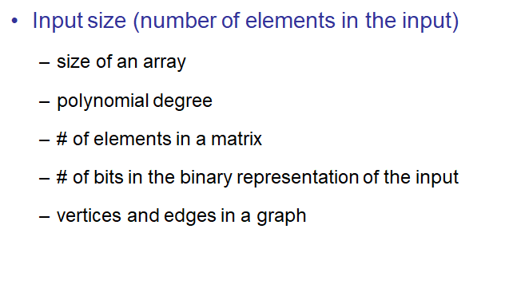
Input Size

Slide 4
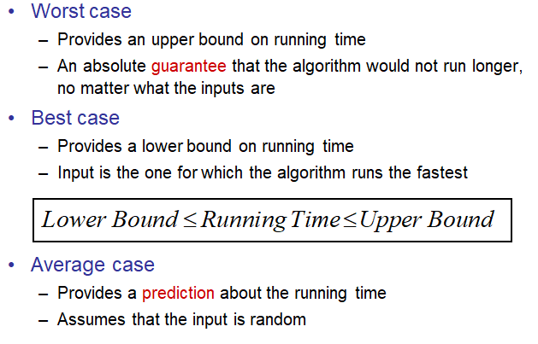
Types of Analysis

Slide 5
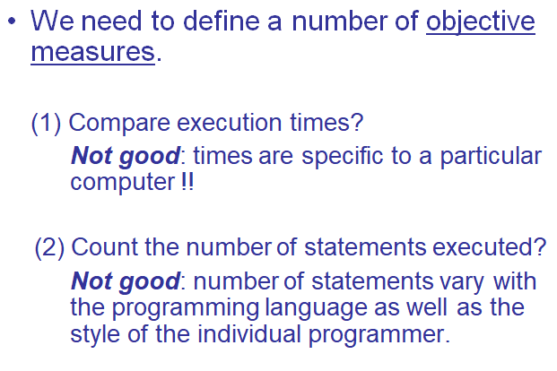
How do we compare algorithms?

Slide 6
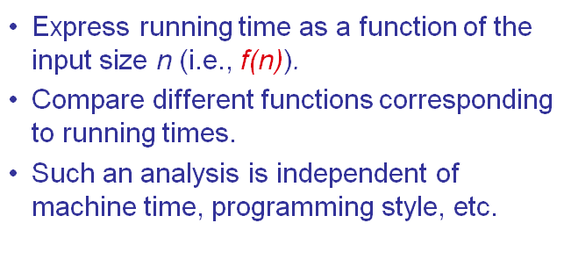
Ideal Solution

Slide 7
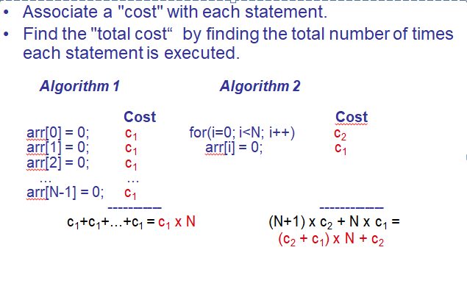
Example

Slide 8
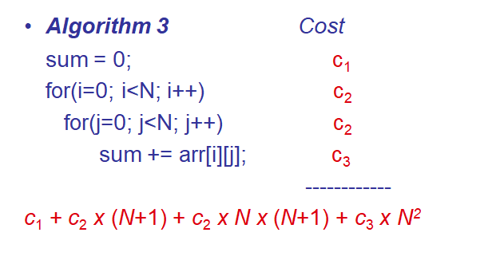
Another Example

Slide 9
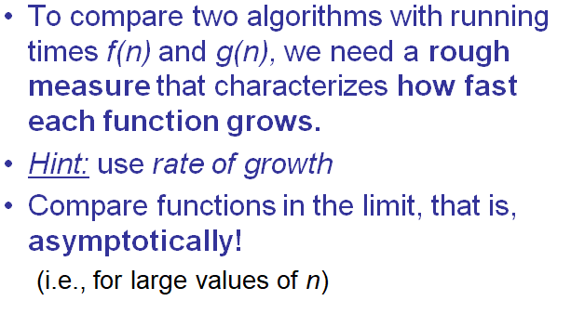
Asymptotic Analysis

Slide 10
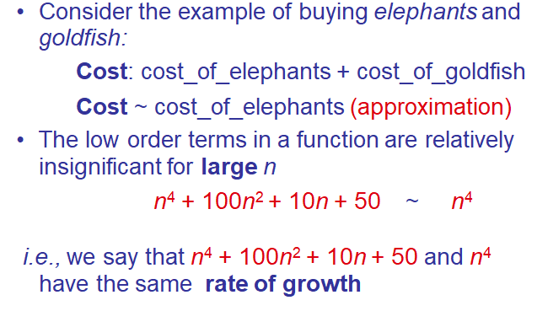
Rate of Growth

Slide 11
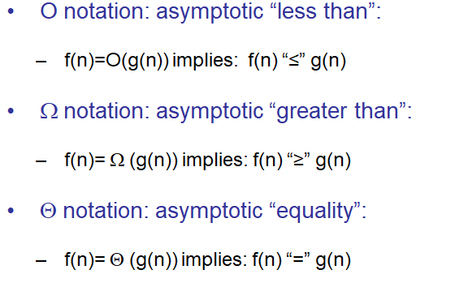
Asymptotic Notation

Slide 12
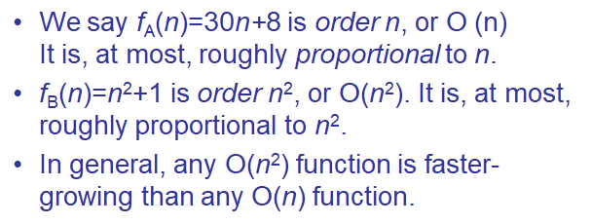
Big-O Notation

Slide 13
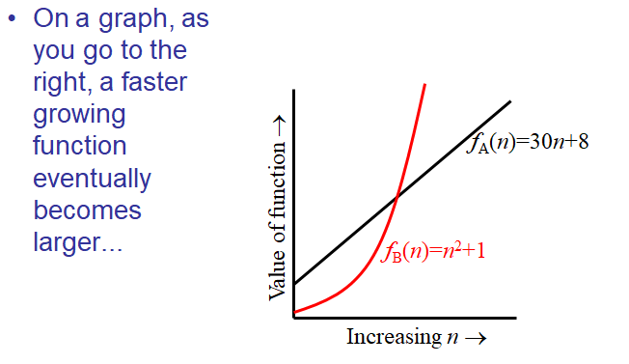
Visualizing Orders of Growth

Slide 14
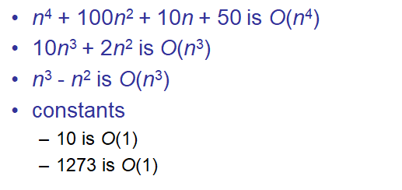
More Examples …

Slide 15
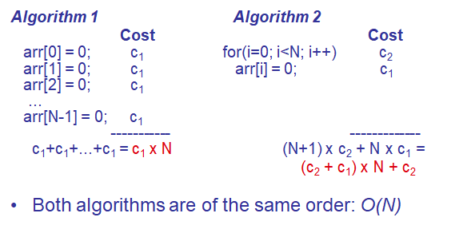
Back to Our Example

Slide 16
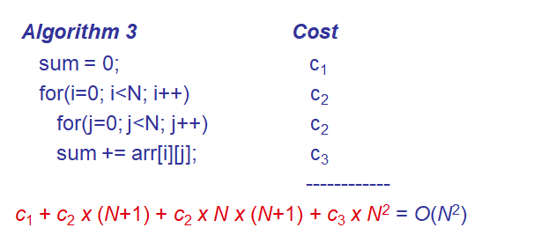
Example (cont’d)

Slide 17
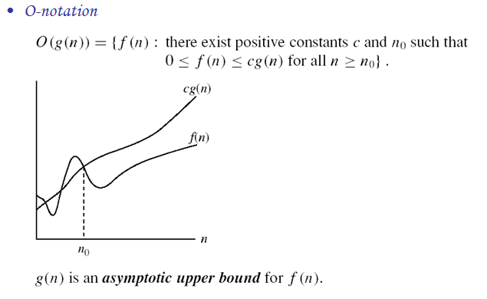
Asymptotic notations

Slide 18
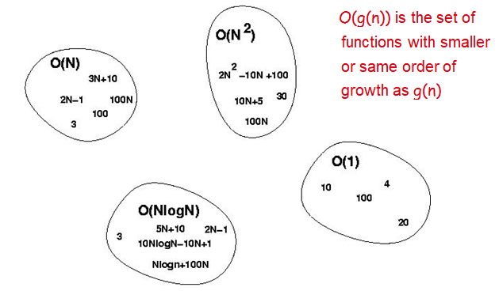
Big-O Visualization

Slide 19
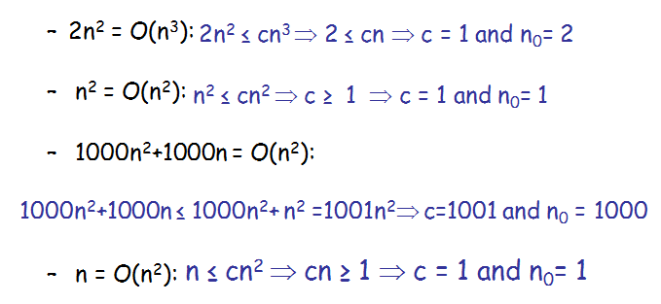
Examples

Slide 20

More Examples

Slide 21
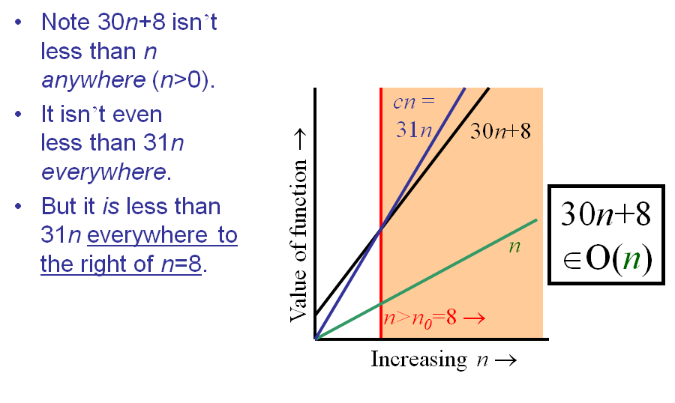
Big-O example, graphically

Slide 22
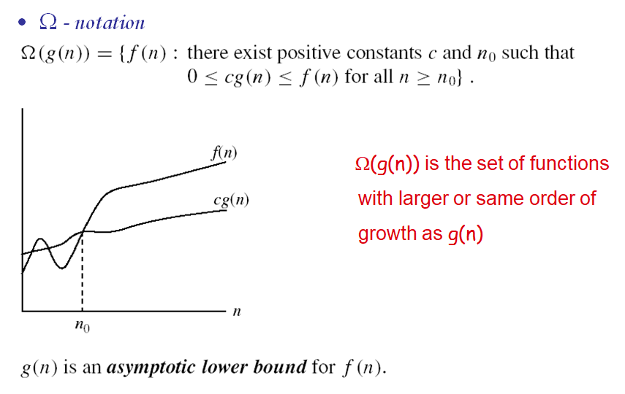
Asymptotic notations (cont.)

Slide 23
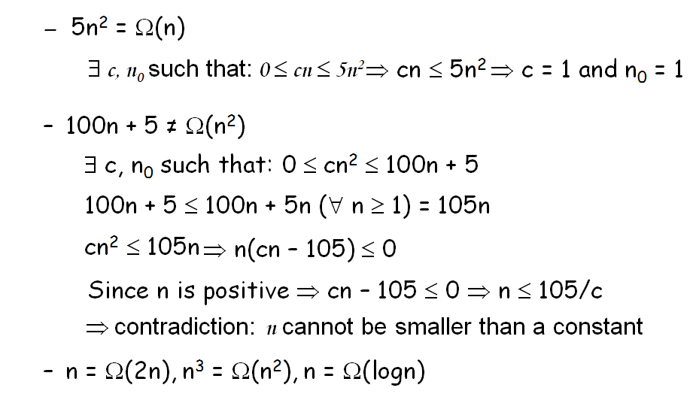
Examples

Slide 24
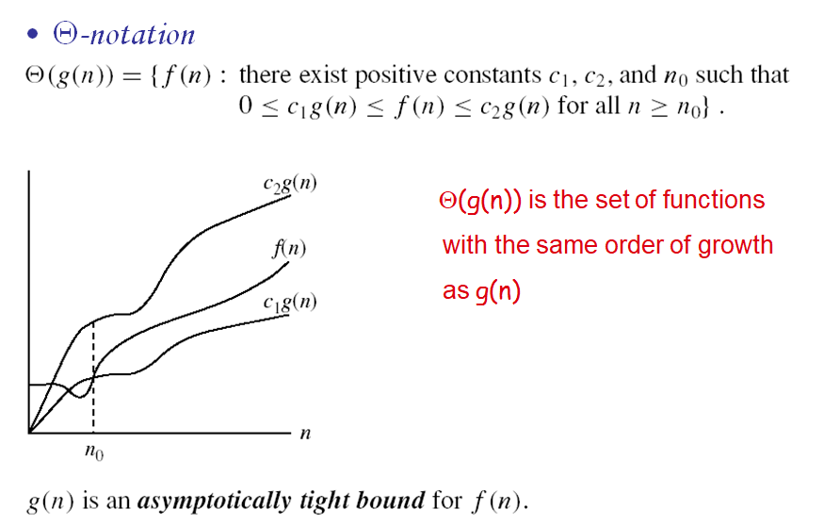
Asymptotic notations (cont.)

Slide 25
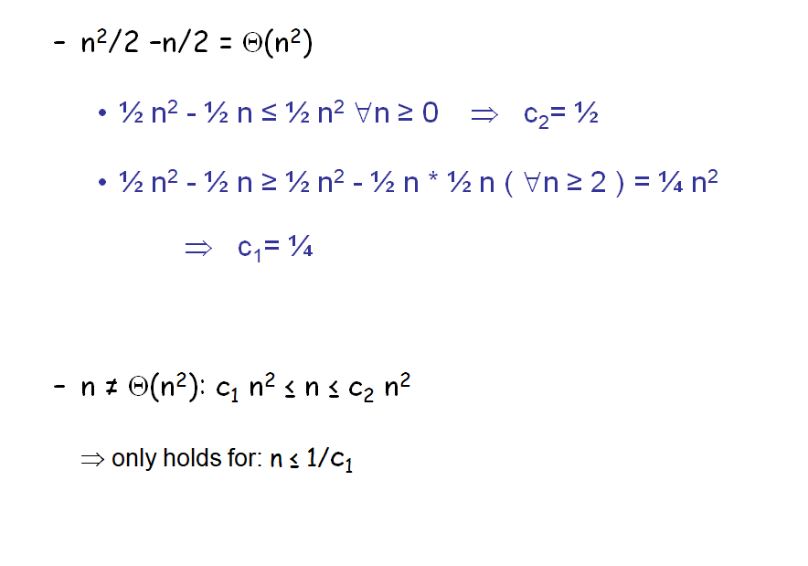
Examples

Slide 26
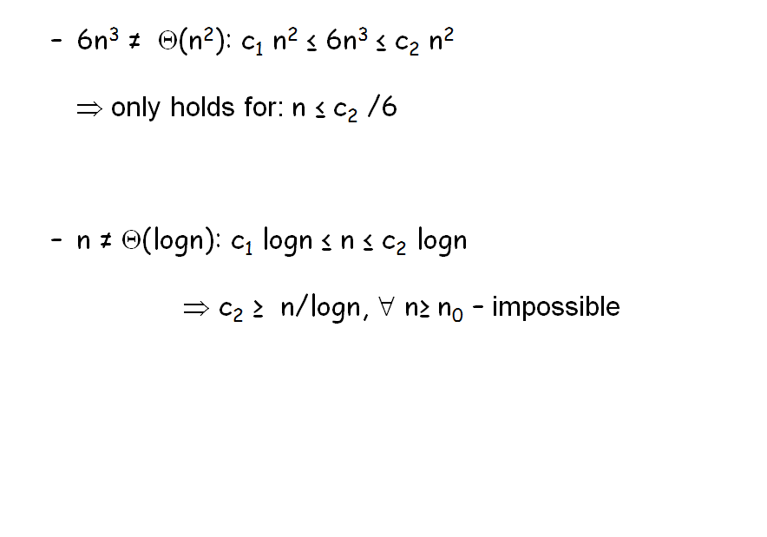
Examples

Slide 27
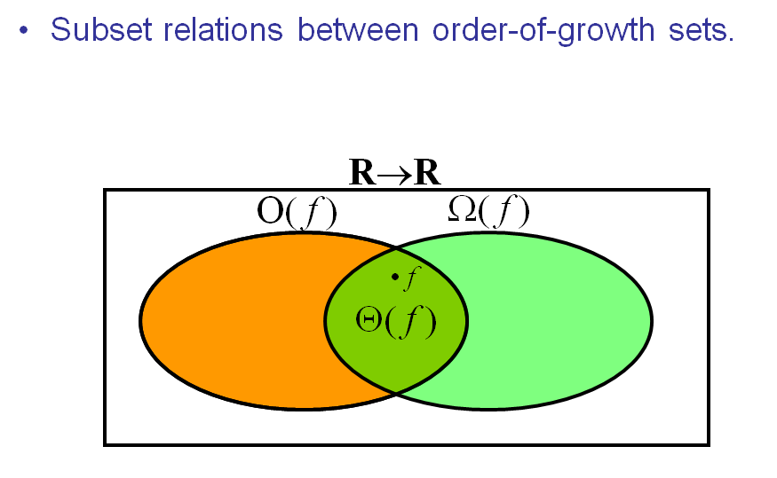
Relations Between Different Sets

Slide 28
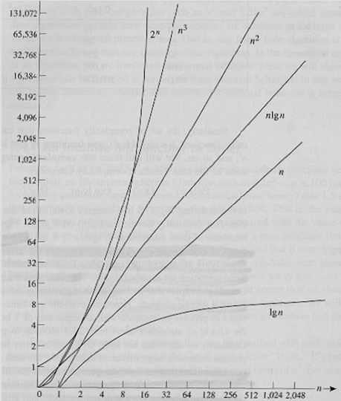
Common orders of magnitude

Slide 29
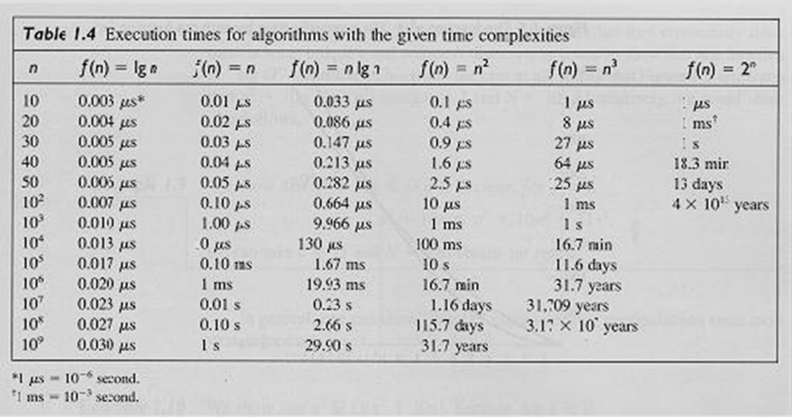
Common orders of magnitude

Slide 30
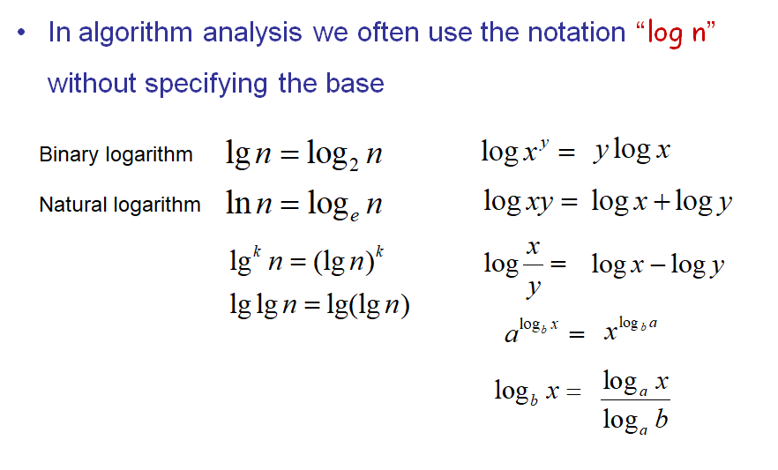
Logarithms and properties

Slide 31
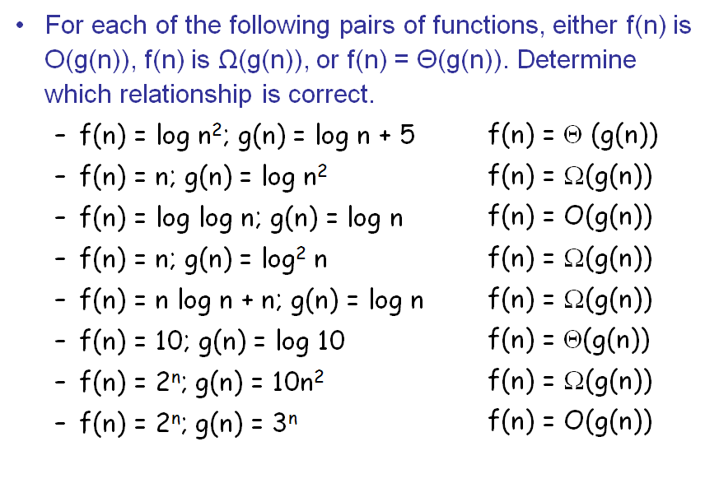
More Examples

Slide 32
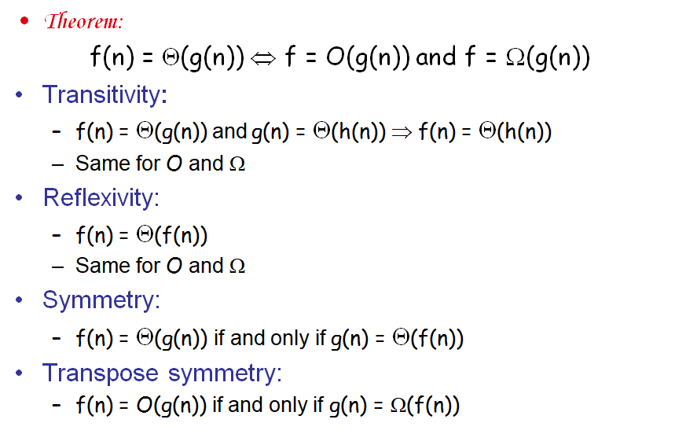
Properties

Slide 33
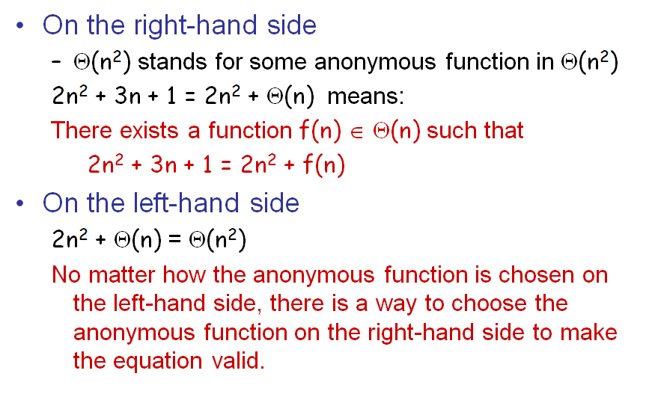
Asymptotic Notations in Equations

Slide 34
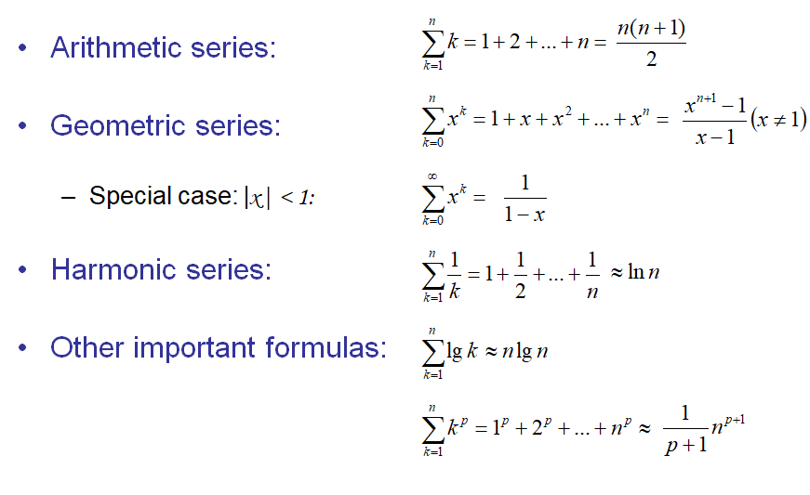
Common Summations

